Slide 1

Nonlinear Models
This lecture corresponding to textbook sections 7.1-7.5 and 7.7
Intro to Statistical and Machine Learning
Duo Yu
October 3, 2023

Slide 2
Outline
Polynomial regression
Step functions
Splines
Smoothing splines
Generalized additive models (GAMs)

Slide 3
Beyond Linearity
The truth is never linear! Or almost never!
But often the linearity assumption is good enough.
When it’s not . . .
Polynomials
Step functions
Splines
Local regression
Generalized additive models
Offer a lot of flexibility, without losing the ease and interpretability of linear models.

Slide 4
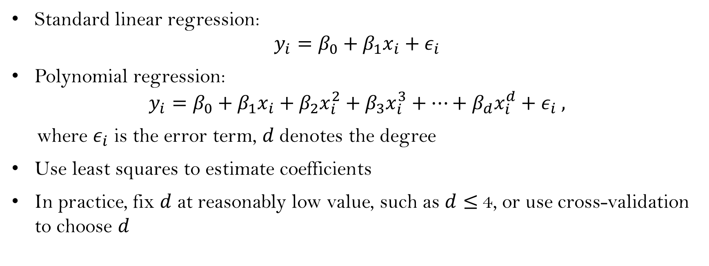
Polynomial regression
Standard linear regression:
$$y_{i}=β_{0}+β_{1}x_{i}+ε_{i}$$
Polynomial regression:
$$y_{i}=β_{0}+β_{1}x_{i}+β_{2}x_{i}^{2}+β_{3}x_{i}^{3}+⋯+β_{d}x_{i}^{d}+ε_{i} ,$$
where $ε_{i}$ is the error term, $d$ denotes the degree
Use least squares to estimate coefficients
In practice, fix $d$ at reasonably low value, such as $d≤$4, or use cross-validation to choose $d$

Slide 5
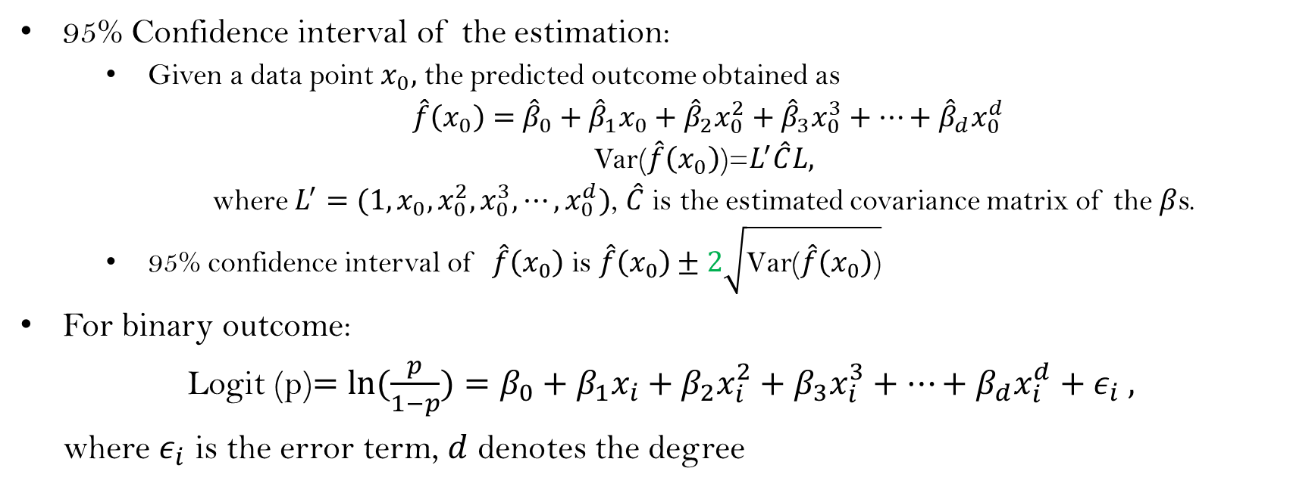
Polynomial regression: cont.
95% Confidence interval of the estimation:
Given a data point $x_{0},$ the predicted outcome obtained as
$\hat{f}\left(x_{0}\right)=$ ${\hat{β}}_{0}+{\hat{β}}_{1}x_{0}+{\hat{β}}_{2}x_{0}^{2}+{\hat{β}}_{3}x_{0}^{3}+⋯+{\hat{β}}_{d}x_{0}^{d}$
Var($\hat{f}\left(x_{0}\right)$)=$L^{′}\hat{C}L,$
where $L^{′}=(1,x_{0},x_{0}^{2},x_{0}^{3},⋯,x_{0}^{d})$, $\hat{C}$ is the estimated covariance matrix of the $β$s.
95% confidence interval of $\hat{f}\left(x_{0}\right)$ is $\hat{f}\left(x_{0}\right)±2\sqrt{\text{Var}\text{(}\hat{f}\left(x_{0}\right)\text{)}}$
For binary outcome:
Logit (p)$=ln(\frac{p}{1−p})=β_{0}+β_{1}x_{i}+β_{2}x_{i}^{2}+β_{3}x_{i}^{3}+⋯+β_{d}x_{i}^{d}+ε_{i} ,$
where $ε_{i}$ is the error term, $d$ denotes the degree

Slide 6
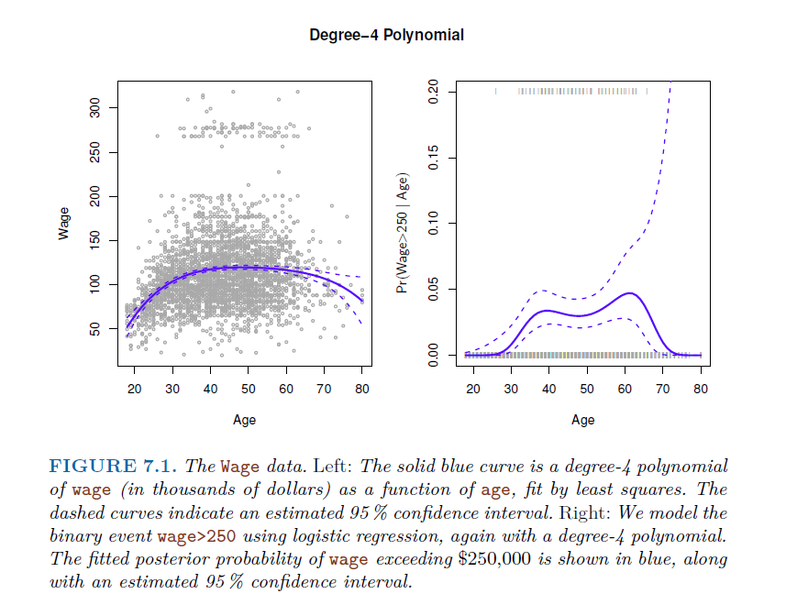

Slide 7
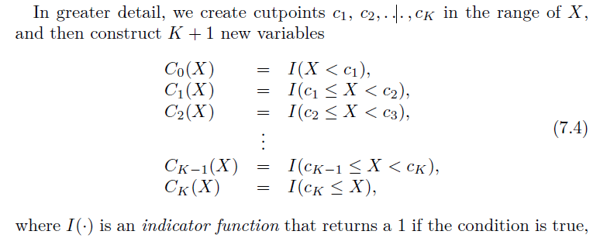
Step function
Break range of X into bins, fit different coefficient to each bin
That is transform a continuous variable to ordered categorical variable (dummy variables)

Slide 8
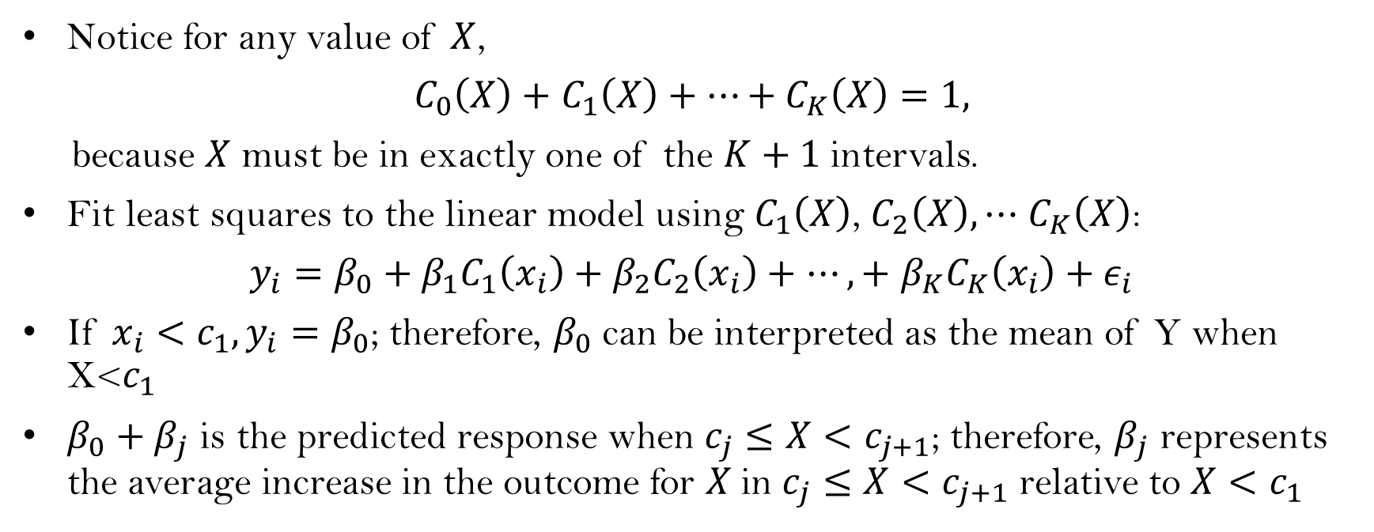
Step function: cont.
Notice for any value of $X$,
$C_{0}\left(X\right)+$ $C_{1}\left(X\right)+⋯+C_{K}\left(X\right)=1,$
because $X$ must be in exactly one of the $K+1$ intervals.
Fit least squares to the linear model using $C_{1}\left(X\right)$, $C_{2}\left(X\right),⋯$ $C_{K}\left(X\right)$:
$y_{i}=β_{0}+β_{1}C_{1}\left(x_{i}\right)+$ $β_{2}C_{2}\left(x_{i}\right)+$ $⋯,+$ $β_{K}C_{K}\left(x_{i}\right)+ε_{i}$
If $x_{i}<c_{1}, y_{i}=β_{0}$; therefore, $β_{0}$ can be interpreted as the mean of Y when X<$c_{1}$
$β_{0}+β_{j}$ is the predicted response when $c_{j}≤X<c_{j+1}$; therefore, $β_{j}$ represents the average increase in the outcome for $X$in $c_{j}≤X<c_{j+1}$ relative to $X<c_{1}$

Slide 9
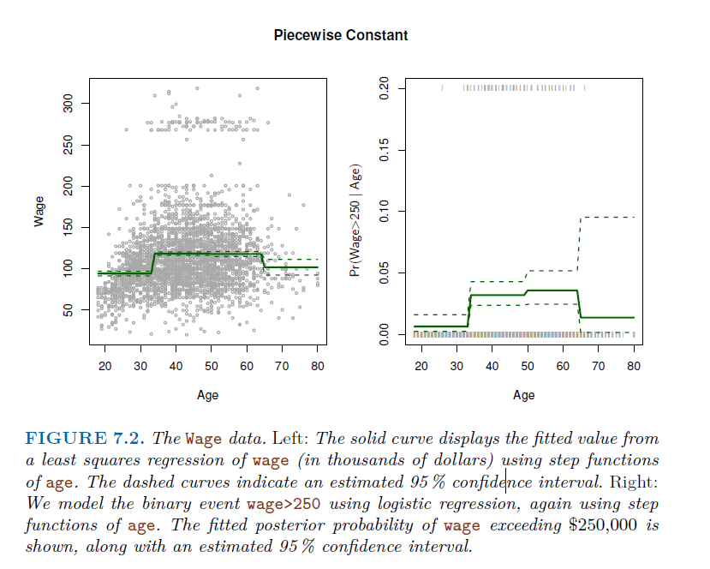
Unless, there are natural breakpoints in the predictors, piecewise-constant function may not capture the curve trend
For example, left figure, piecewise-constant function does not capture the increasing trend as age increase from 20 to 40.

Slide 10
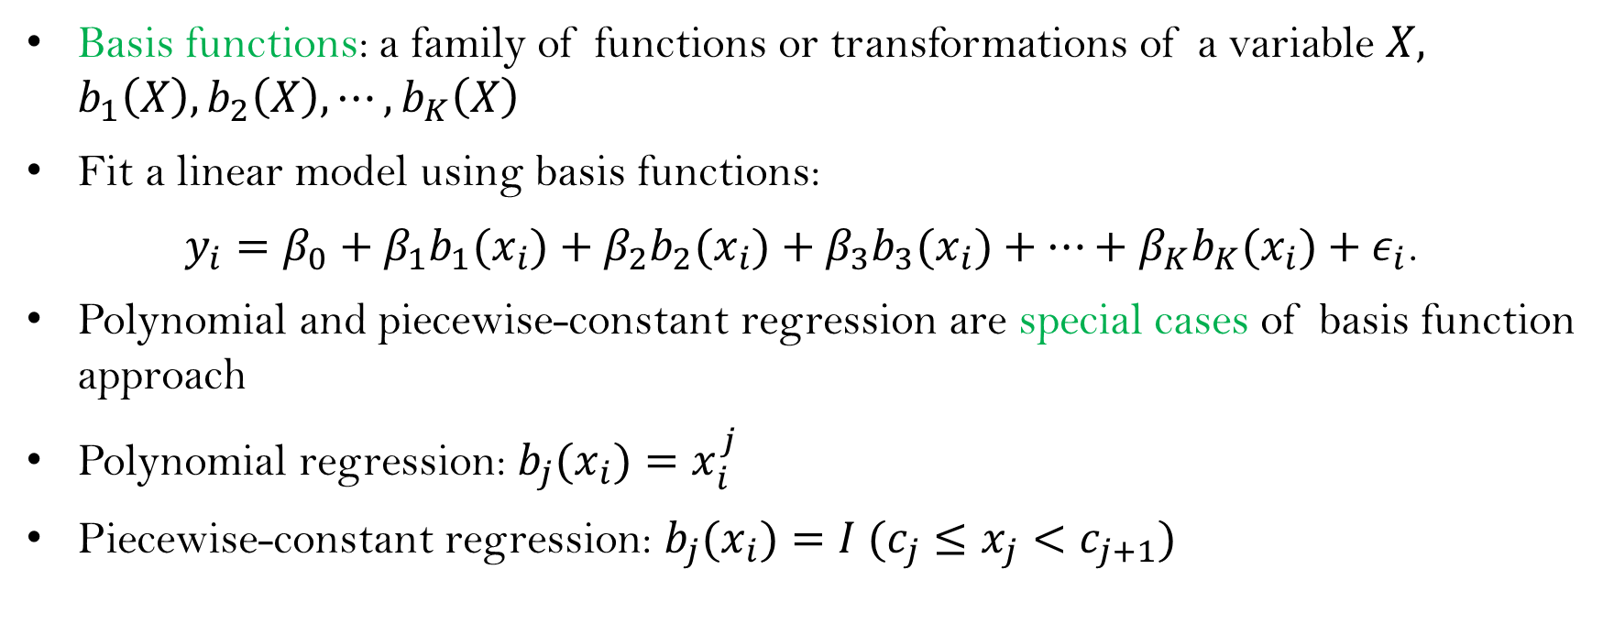
Basis functions
Basis functions: a family of functions or transformations of a variable $X,$ $b_{1}\left(X\right), b_{2}\left(X\right), ⋯,b_{K}\left(X\right)$
Fit a linear model using basis functions:
$y_{i}=β_{0}+β_{1}{b_{1}(x}_{i})+β_{2}{b_{2}(x}_{i})+β_{3}{b_{3}(x}_{i})+⋯+β_{K}{b_{K}(x}_{i})+ε_{i}$.
Polynomial and piecewise-constant regression are special cases of basis function approach
Polynomial regression: ${b_{j}(x}_{i})=x_{i}^{j}$
Piecewise-constant regression: ${b_{j}(x}_{i})=I (c_{j}≤x_{j}<c_{j+1})$

Slide 11
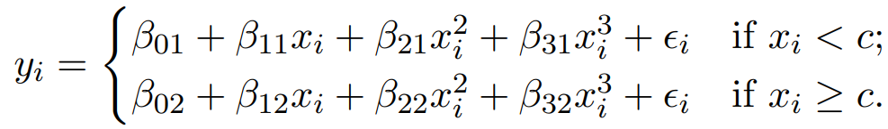
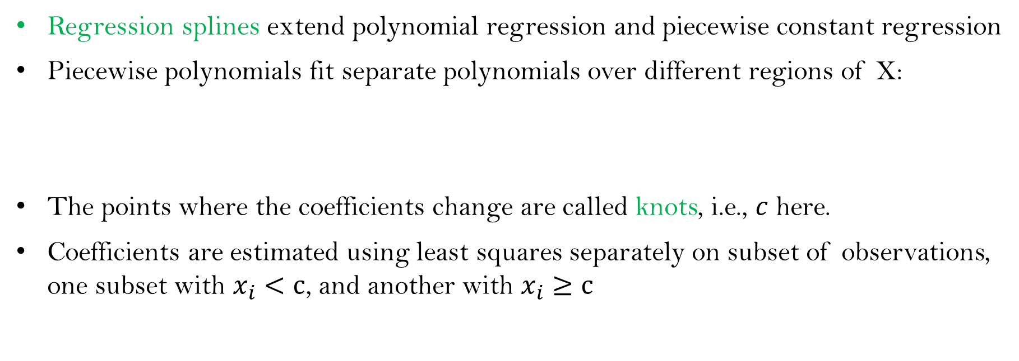
Regression splines: piecewise polynomials
Regression splines extend polynomial regression and piecewise constant regression
Piecewise polynomials fit separate polynomials over different regions of X:
The points where the coefficients change are called knots, i.e., $c$ here.
Coefficients are estimated using least squares separately on subset of observations, one subset with $x_{i}<c$, and another with $x_{i}≥c$

Slide 12
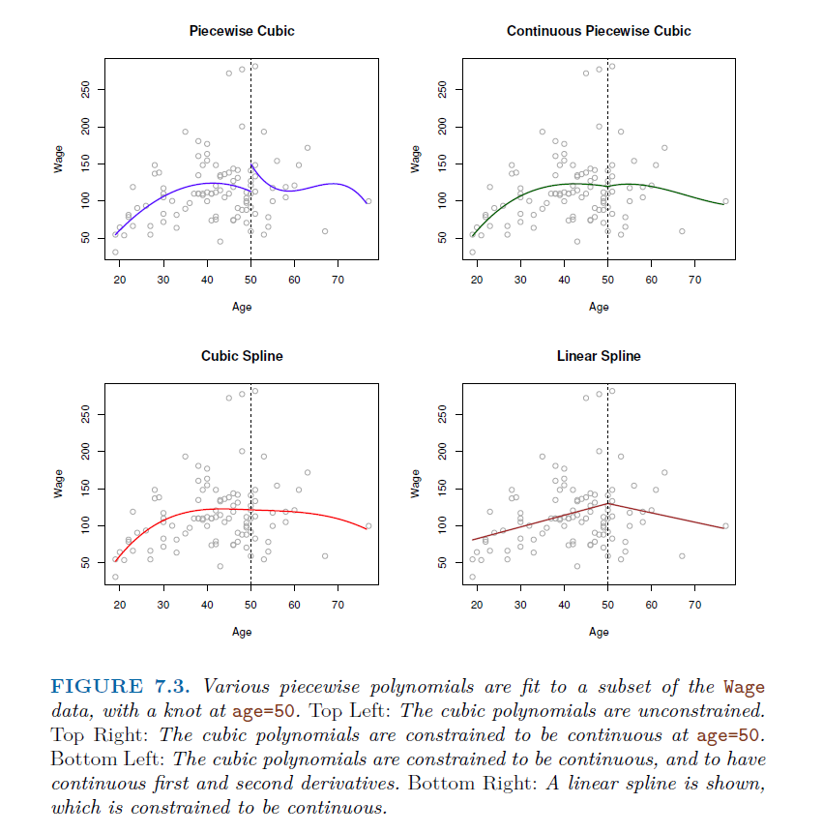

Slide 13
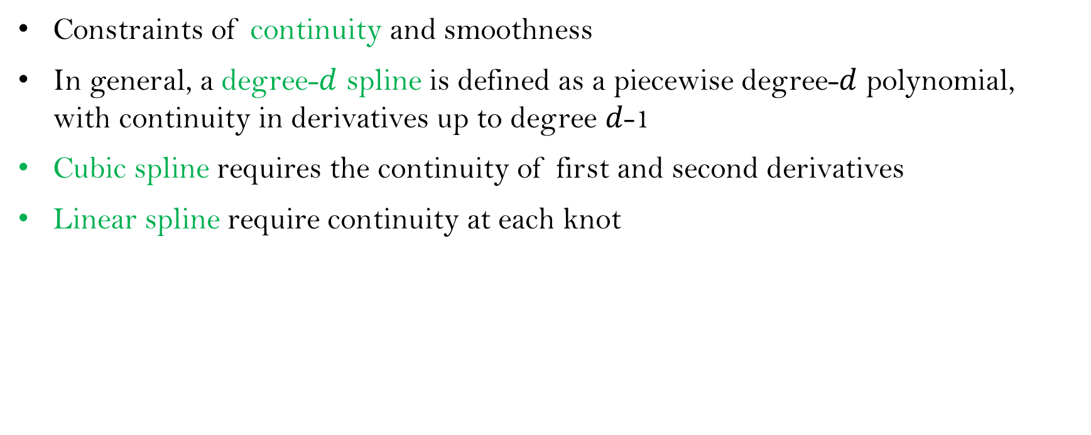
Constraints and Splines
Constraints of continuity and smoothness
In general, a degree-$d$ spline is defined as a piecewise degree-$d$ polynomial, with continuity in derivatives up to degree $d$-1
Cubic spline requires the continuity of first and second derivatives
Linear spline require continuity at each knot

Slide 14

Linear spline
A linear spline with $K$ knots:
$$y_{i}=β_{0}+β_{1}x_{i}+β_{2}{(x_{i}−ξ_{1})}_{+}+β_{3}{(x_{i}−ξ_{2})}_{+}+⋯+β_{K+1}{(x_{i}−ξ_{K})}_{+}+ε_{i}$$
where
$${(x_{i}−ξ_{j})}_{+}=\left\{\begin{aligned}\left(x_{i}−ξ_{j}\right), if x>ξ_{j} \\ 0 otherwise,\end{aligned}\right.$$
$ξ_{1},⋯ξ_{K}$ are the knots
Estimating a total of K+2 coefficients

Slide 15
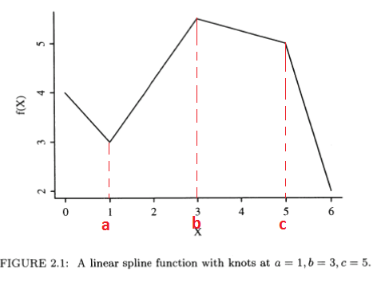

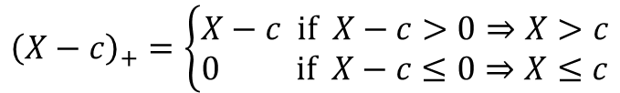
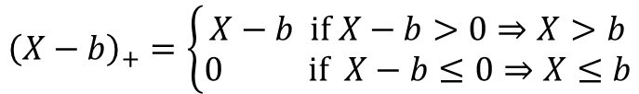
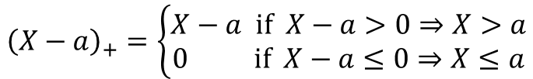
Linear spline example
Suppose that the x axis is divided into intervals with knots, a, b, and c. The linear spline functions is given by
$$f\left(X\right)=β_{0}+β_{1}X+β_{2}{\left(X−a\right) }_{+}+β_{3}{\left(X−b\right) }_{+}+β_{4}{\left(X−c\right) }_{+}$$
where ${\left(u\right) }_{+}=\left\{\begin{aligned}&u, u>0 \\ &0, u≤0\end{aligned}\right.$
$${\left(X−a\right)}_{+}=\left\{\begin{aligned}X−a if X−a>0⇒X>a \\ 0 if X−a≤0⇒X≤a\end{aligned}\right.$$
$${\left(X−b\right)}_{+}=\left\{\begin{aligned}X−b if X−b>0⇒X>b \\ 0 if X−b≤0⇒X≤b\end{aligned}\right.$$
$${\left(X−c\right)}_{+}=\left\{\begin{aligned}X−c if X−c>0⇒X>c \\ 0 if X−c≤0⇒X≤c\end{aligned}\right.$$

Slide 16
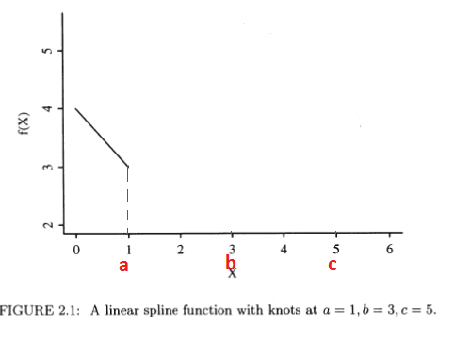
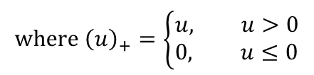



Linear spline example: cont.
What does the equation of the model in each interval look like?
Case: 𝑋≤𝑎
$$where {\left(u\right)}_{+}=\left\{\begin{aligned}&u, u>0 \\ &0, u≤0\end{aligned}\right.$$
$$f\left(X\right)=β_{0}+β_{1}X+β_{2}{\left(X−a\right) }_{+}+β_{3}{\left(X−b\right) }_{+}+β_{4}{\left(X−c\right) }_{+}$$
$${X≤a⇒X−a≤0⇒\left(X−a\right)}_{+}=0$$
Then, if
$$X≤a$$
$$(X≤a<b<c)$$
$$f\left(X\right)=β_{0}+β_{1}X$$

Slide 17
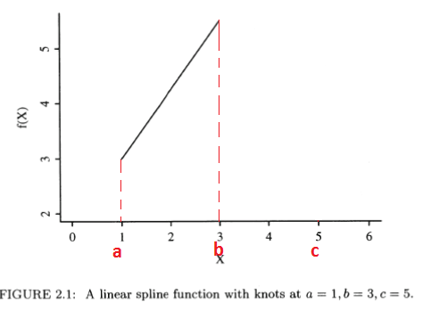


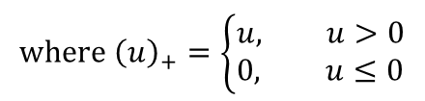



Case: $a<X≤b$
$$where {\left(u\right)}_{+}=\left\{\begin{aligned}&u, u>0 \\ &0, u≤0\end{aligned}\right.$$
$$f\left(X\right)=β_{0}+β_{1}X+β_{2}{\left(X−a\right) }_{+}+β_{3}{\left(X−b\right) }_{+}+β_{4}{\left(X−c\right) }_{+}$$
$${X>a⇒X−a>0⇒\left(X−a\right)}_{+}=X−a$$
$${X≤b⇒X−b≤0⇒\left(X−b\right)}_{+}=0$$
Then, if
$$a<X≤b$$
$$f\left(X\right)=β_{0}+β_{1}X+β_{2}\left(X−a\right)$$
$$={(β}_{0}−β_{2}a)+{(β}_{1}+β_{2})X$$
$$(a<X≤b<c)$$

Slide 18
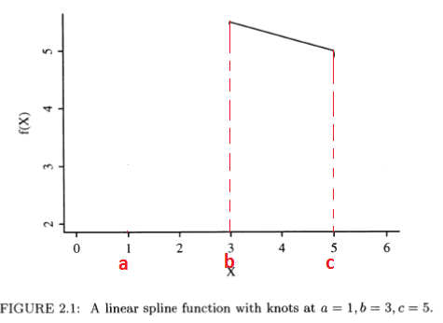




Case: $b<X≤c$
$$f\left(X\right)=β_{0}+β_{1}X+β_{2}{\left(X−a\right) }_{+}+β_{3}{\left(X−b\right) }_{+}+β_{4}{\left(X−c\right) }_{+}$$
$${X>b⇒X−b>0⇒\left(X−b\right)}_{+}=X−b$$
$${X≤c⇒X−c≤0⇒\left(X−c\right)}_{+}=0$$
Then, if
$$b<X≤c$$
$$f\left(X\right)=β_{0}+β_{1}X+β_{2}\left(X−a\right)+β_{3}\left(X−b\right)$$
$$={(β}_{0}−β_{2}a−β_{3}b)+{(β}_{1}+β_{2}+β_{3})X$$
$$(a<b<X≤c)$$

Slide 19
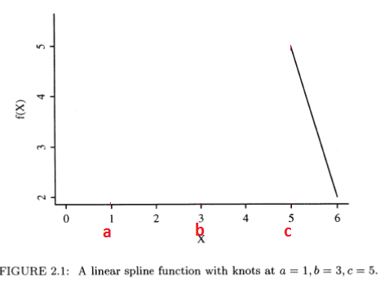






Case: $X>c$
$$f\left(X\right)=β_{0}+β_{1}X+β_{2}{\left(X−a\right) }_{+}+β_{3}{\left(X−b\right) }_{+}+β_{4}{\left(X−c\right) }_{+}$$
$${X>c⇒X−c>0⇒\left(X−c\right)}_{+}=X−c$$
Then, if
$$X>c$$
$$f\left(X\right)=β_{0}+β_{1}X+β_{2}\left(X−a\right)+β_{3}\left(X−b\right)$$
$$+β_{4}\left(X−c\right)$$
$$={(β}_{0}−β_{2}a−β_{3}b−β_{4}c)+$$
$${(β}_{1}+β_{2}+β_{3}+β_{4})X$$
$$(a<b<c<X)$$

Slide 20
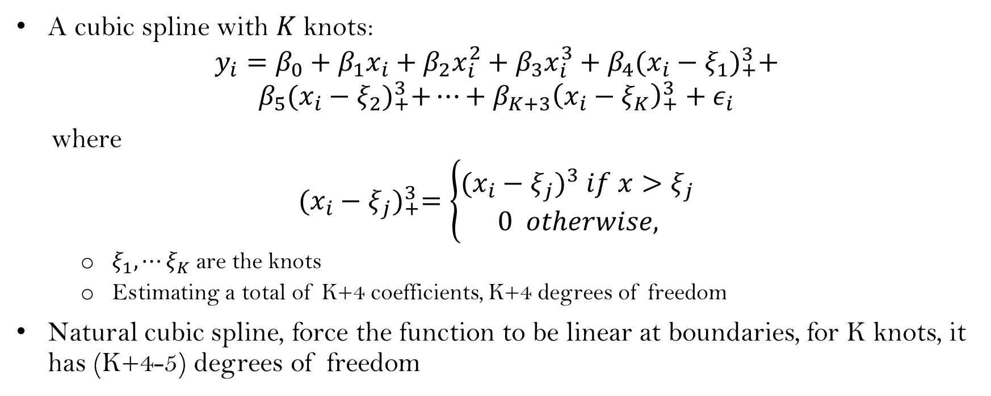
Cubic spline
A cubic spline with $K$ knots:
$$y_{i}=β_{0}+β_{1}x_{i}+β_{2}x_{i}^{2}+β_{3}x_{i}^{3}+β_{4}{(x_{i}−ξ_{1})}_{+}^{3}+$$
$$β_{5}{(x_{i}−ξ_{2})}_{+}^{3}+⋯+β_{K+3}{\left(x_{i}−ξ_{K}\right)}_{+}^{3}+ε_{i}$$
where
$${(x_{i}−ξ_{j})}_{+}^{3}=\left\{\begin{aligned}{(x_{i}−ξ_{j})}^{3} if x>ξ_{j} \\ 0 otherwise,\end{aligned}\right.$$
$ξ_{1},⋯ξ_{K}$ are the knots
Estimating a total of K+4 coefficients, K+4 degrees of freedom
Natural cubic spline, force the function to be linear at boundaries, for K knots, it has (K+4-5) degrees of freedom

Slide 21
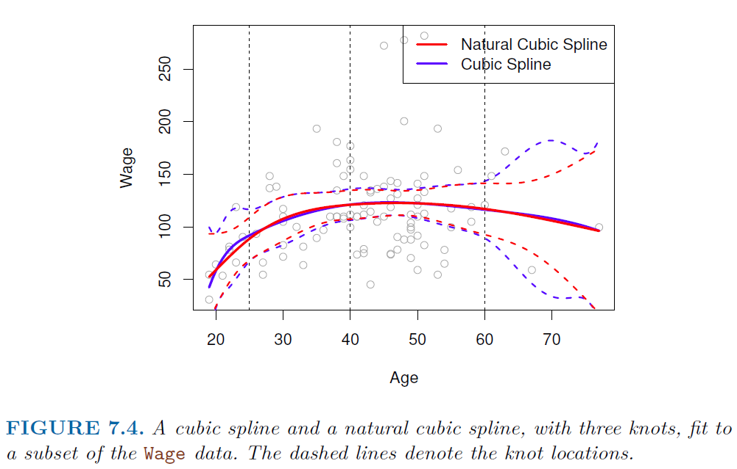

Slide 22
Knot placement
One strategy: place more knots in places where you feel the function might vary most rapidly, and place fewer knots where it seems more stable
Commonly, place knots in a uniform fashion
decide number of knots, using cross-validation
place knots at appropriate quantiles of the observed X

Slide 23
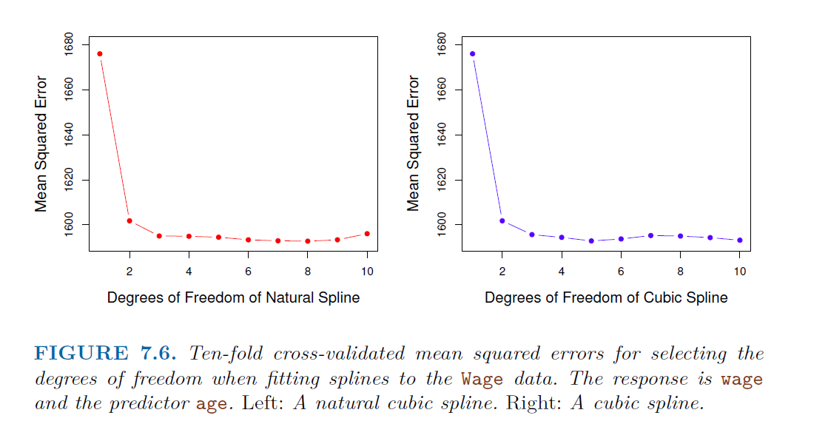

Slide 24
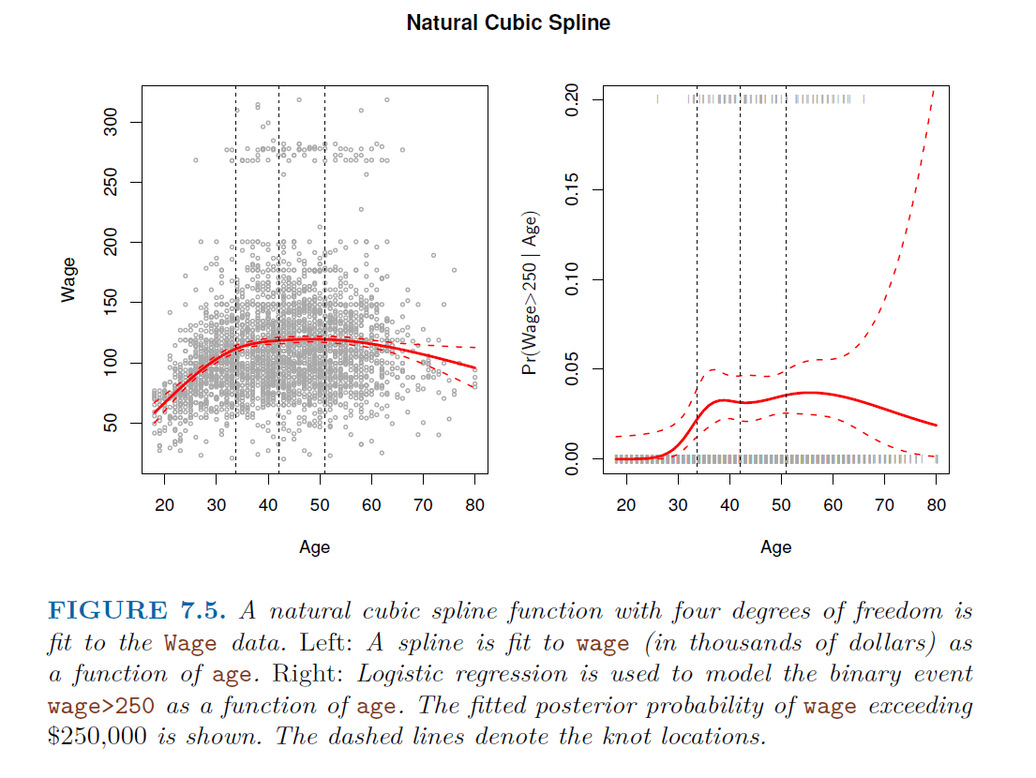

Slide 25
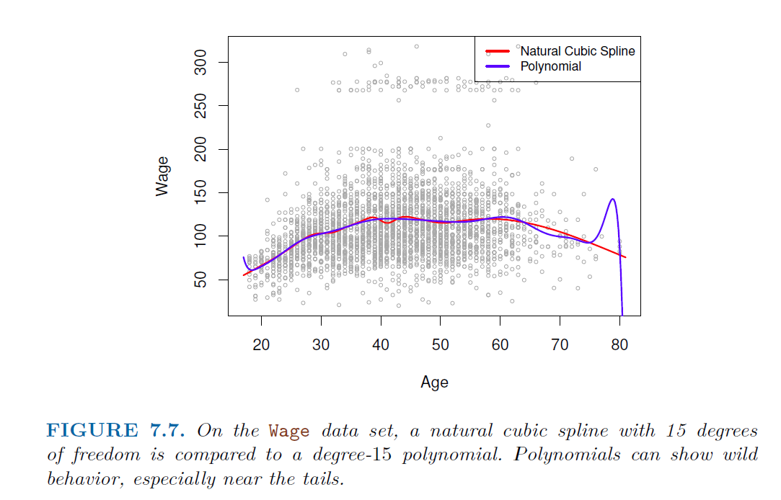
Splines vs. Polynomials
Regression splines often give superior results to polynomial regression
Splines introduce flexibility by increasing the number of knots but keep the degree fixed
Polynomials tend to extrapolate badly

Slide 26
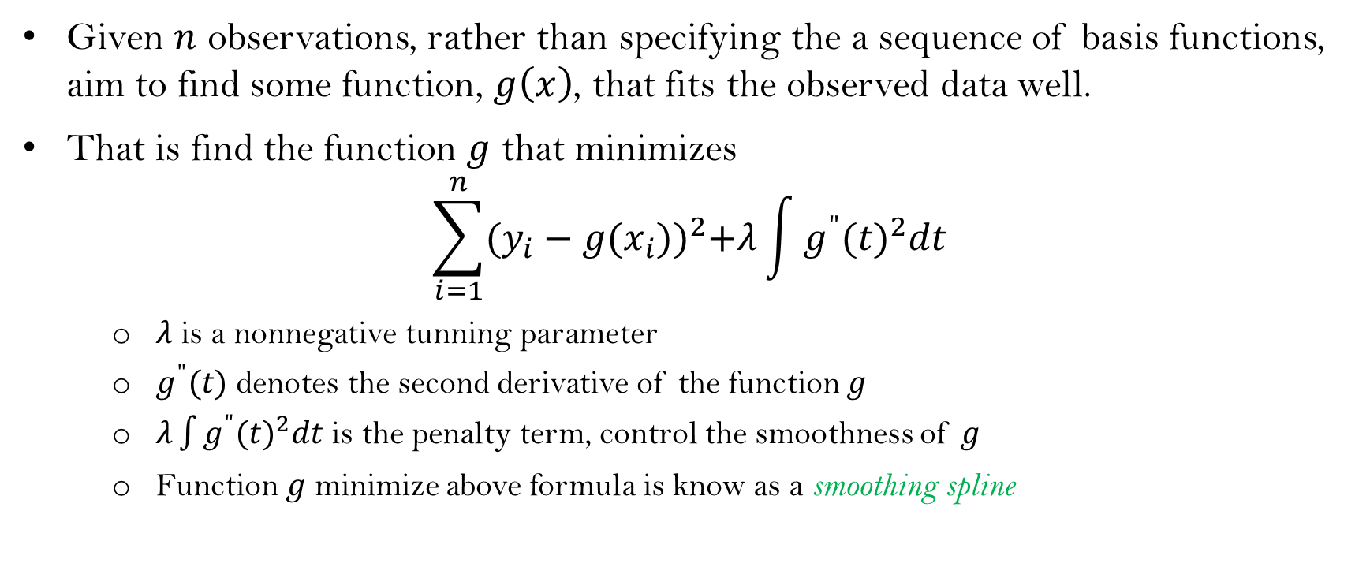
Smoothing splines
Given $n$ observations, rather than specifying the a sequence of basis functions, aim to find some function, $g\left(x\right)$, that fits the observed data well.
That is find the function $g$ that minimizes
$$\sum_{i=1}^{n}{{(y_{i}−g(x_{i}))}^{2}+λ\int{{g^{"}(t)}^{2}dt}}$$
$λ$ is a nonnegative tunning parameter
$g^{"}(t)$ denotes the second derivative of the function $g$
$λ\int{{g^{"}(t)}^{2}dt}$ is the penalty term, control the smoothness of $g$
Function $g$ minimize above formula is know as a smoothing spline

Slide 27
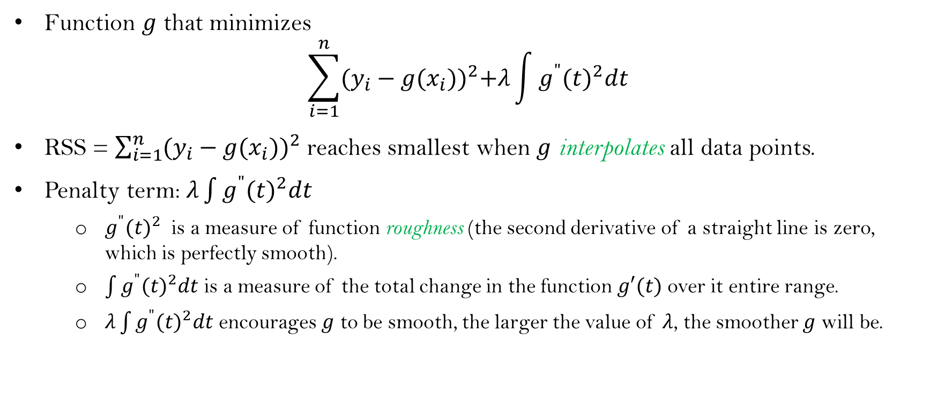
Smoothing splines: cont.
Function $g$ that minimizes
$$\sum_{i=1}^{n}{{(y_{i}−g(x_{i}))}^{2}+λ\int{{g^{"}(t)}^{2}dt}}$$
RSS = $\sum_{i=1}^{n}{{(y_{i}−g(x_{i}))}^{2}}$ reaches smallest when $g$ interpolates all data points.
Penalty term: $λ\int{{g^{"}(t)}^{2}dt}$
${g^{"}(t)}^{2}$ is a measure of function roughness (the second derivative of a straight line is zero, which is perfectly smooth).
$\int{{g^{"}(t)}^{2}dt}$ is a measure of the total change in the function $g′(t)$ over it entire range.
$λ\int{{g^{"}(t)}^{2}dt}$ encourages $g$ to be smooth, the larger the value of $λ$, the smoother $g$ will be.

Slide 28
Smoothing splines: cont.
Smooth spline is a natural cubic spline, with a knot at every unique value of x_{i}.
Avoid the knot-selection issue, leaving a single λ to be chosen. (λ: tuning parameter controls smoothness)
In R, the function smooth.spline() will fit a smoothing spline.
We can also specify df rather than λ
smooth.spline(age, wage, df=16)
The leave-one-out (LOO) cross-validated error,
smooth.spline(age, wage, cv=TRUE)

Slide 29
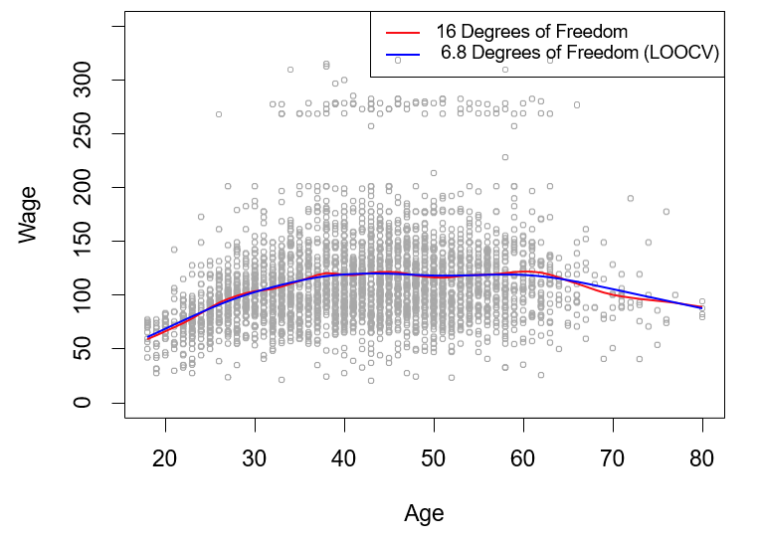
Smoothing splines: cont.
smooth.spline(age, wage, df=16)
smooth.spline(age, wage, cv=TRUE)

Slide 30
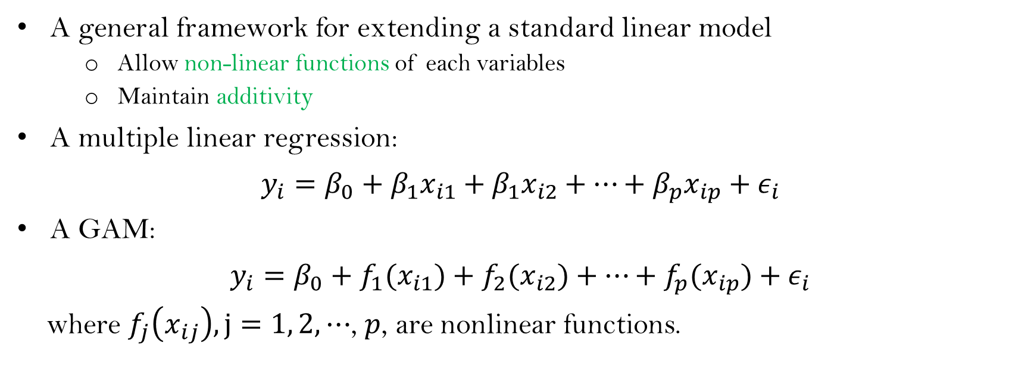
Generalized additive models (GAMs)
A general framework for extending a standard linear model
Allow non-linear functions of each variables
Maintain additivity
A multiple linear regression:
$y_{i}=β_{0}+$ $β_{1}x_{i1}+$ $β_{1}x_{i2}+⋯+β_{p}x_{ip}+ε_{i}$
A GAM:
$y_{i}=β_{0}+$ $f_{1}(x_{i1})+$ $f_{2}(x_{i2})+⋯+f_{p}(x_{ip})+ε_{i}$
where $f_{j}\left(x_{ij}\right), j=1, 2,⋯$, $p$, are nonlinear functions.

Slide 31
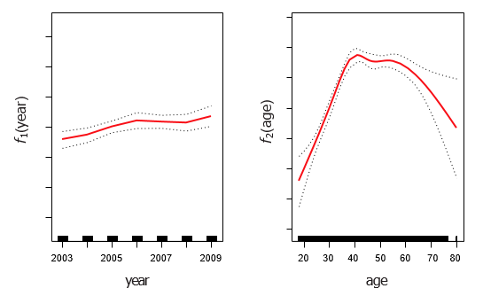
GAMs: cont.
Fit a GAM in R using natural splines
lm(wage ∼ ns(year, df = 4) + ns(age, df = 5) ),
or
gam(wage ∼ ns(year, df = 4) + ns(age, df = 5)

